Slide 1







DATA REPORT
Presented By TEAM 33

Slide 2




STAGES
01
02
03
4
Week 1
Week 2
Week 3
Week 4
Data Understanding, EDA, and Cleaning
Data Transformation & Master Table Creation
Development of Data Visualizations in Looker Studio
Compilation of Findings & Final Presentation

Slide 3


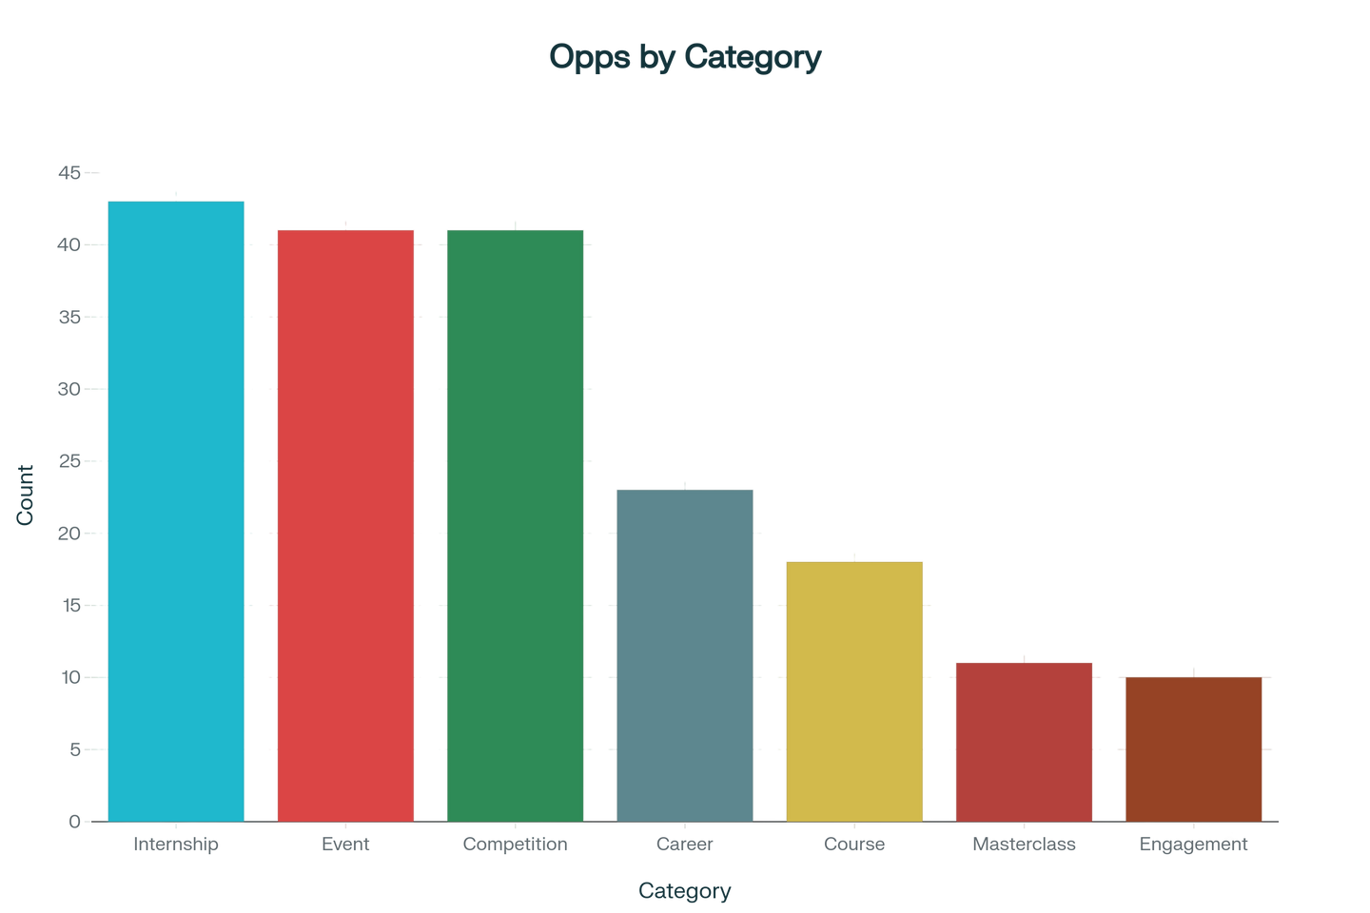


Summary
Key Performance Indicators
The platform demonstrates substantial operational scale:
Total Opportunities Available: 187 programs
Total Marketing Investment: 340,830 AED
Total Marketing Results: 365,031,956 outcomes
Total Cohort Participants: 3,668,770 learners
Global Market Coverage: 154 countries
Opportunity Portfolio Analysis

Slide 4


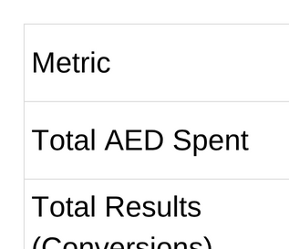




Digital Marketing Campaign Performance

Slide 5



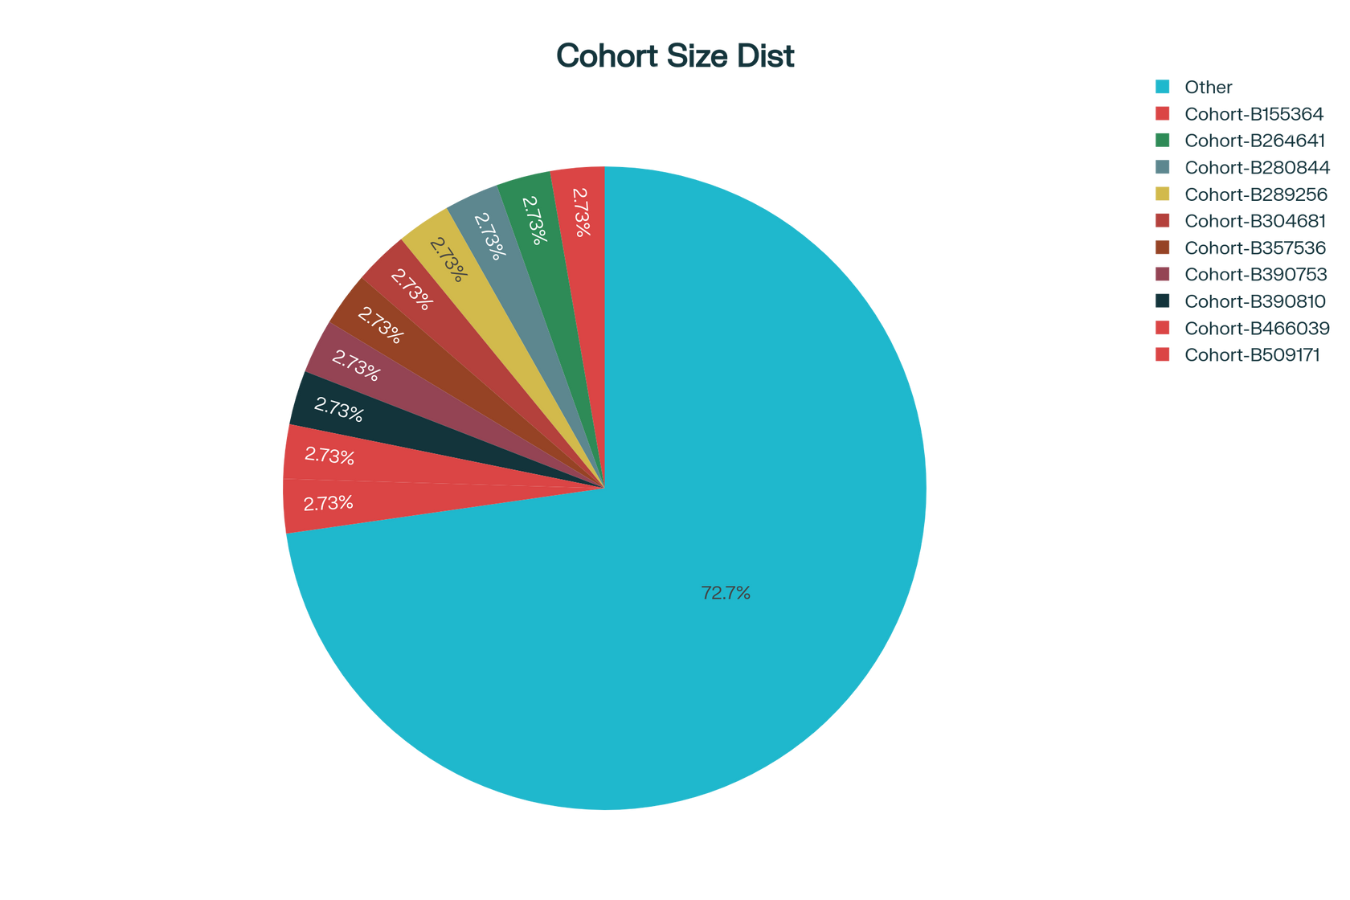

Cohort Size Distribution
Most cohorts fall in the 501–1,000 and 1,000–5,000 participants range.
Very few cohorts exceed 10,000 or are under 100.

Slide 6




Extensive and High-Spending Marketing Campaigns
The marketing_campaign_data.xlsx file reveals large-scale campaigns with some campaigns reaching over 100 million people (e.g., the "March Brand Awareness" campaign with a reach of 141,835,342) and significant ad spend, with individual campaigns sometimes exceeding AED20,000. This demonstrates a robust investment in marketing and substantial efforts to establish brand visibility and drive web applications.
01
Highlights
Diverse and Repeated Program Cohorts
02
The Cohort-transformed.csv file shows a vast number of program cohorts launched over several years, ranging from very small (single-digit) to extremely large sizes (over 100,000 participants in some cohorts). This points to a highly scalable educational or engagement platform that is consistently running and iterating various cohorts to attract diverse audiences.

Slide 7





THANK YOU

